Slide 1




Hospital Pharmacy
Management
system

Slide 2





Introduction
The Hospital pharmacy Management System is a smart digital solution built on a structured database of 12 integrated tables, including patients, prescriptions, medicines, billing, and suppliers. By leveraging this rich data and applying machine learning Random Forest Classifier trained on heart failure data .
The system can uncover hidden patterns, predict patient risks, and support proactive, data-driven healthcare decisions. This integration enhances personalized treatment planning and improved patient outcomes.

Slide 3

Vision
To lead in pharmacy optimization through data-driven insights and predictive care using machine learning on heart failure data.
Mission
To streamline pharmacy workflows and enhance patient care through efficient data solutions powered by machine learning insights.

Slide 4

Our data
We make a machine learning model to predict the heart failure using python on another dataset
We used database of pharmaceutical management system that composed of 9 tables
1) Manufacturer.sql
2) Supplier.sql
3) Manf_Supp_Contract.sql
4) Pharmacy.sql
5) Employee.sql
6) Medicine.sql
7) Pharmacy_Medicines.sql
8) Doctor.sql
9) Patient.sql
10) Prescription.sql
11) Bill.sql
12) Prescribed_Medicines.sql

Slide 5
Predictive modeling using machine learning helps in the early detection and risk assessment of heart failure by analyzing patient data. These models identify key patterns and factors, allowing for faster and more accurate diagnosis. This supports better clinical decisions, improves patient outcomes, and reduces hospital readmissions.
Model overview
Predictive modeling using machine learning helps in the early detection and risk assessment of heart failure by analyzing patient data.
These models identify key patterns and factors, allowing for faster and more accurate diagnosis.
This supports better clinical decisions, improves patient outcomes, and reduces hospital readmissions.

Slide 6
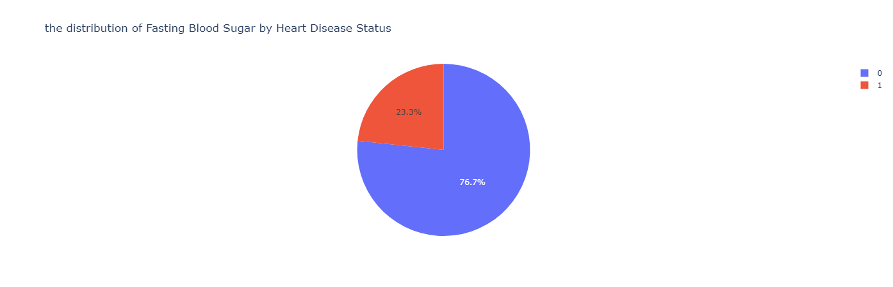
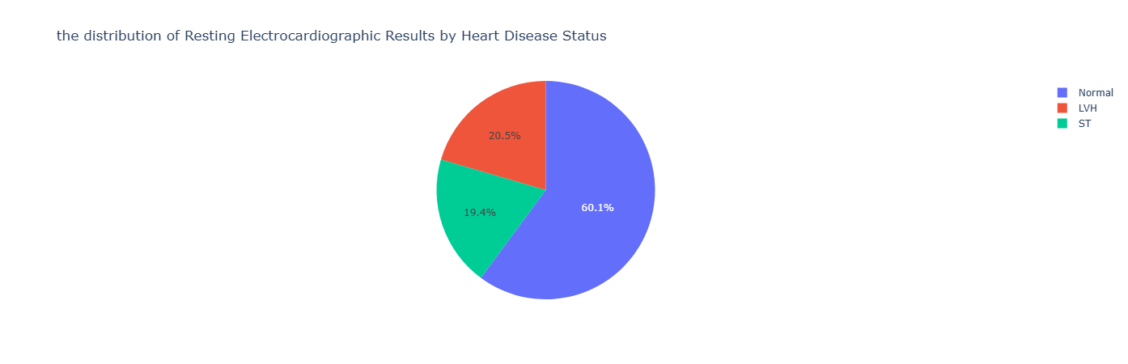

Slide 7
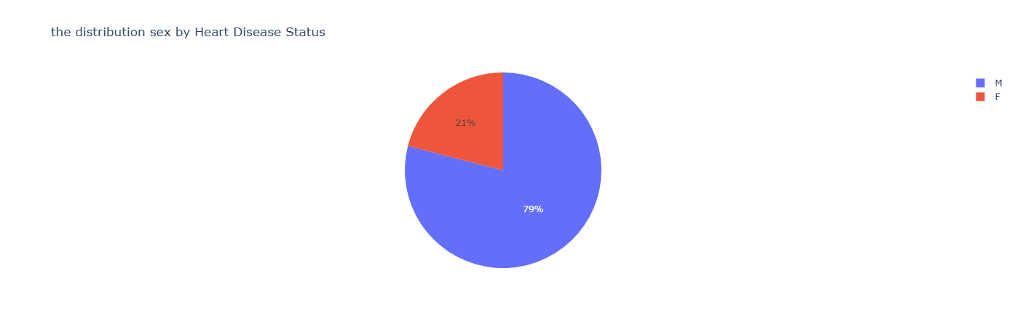
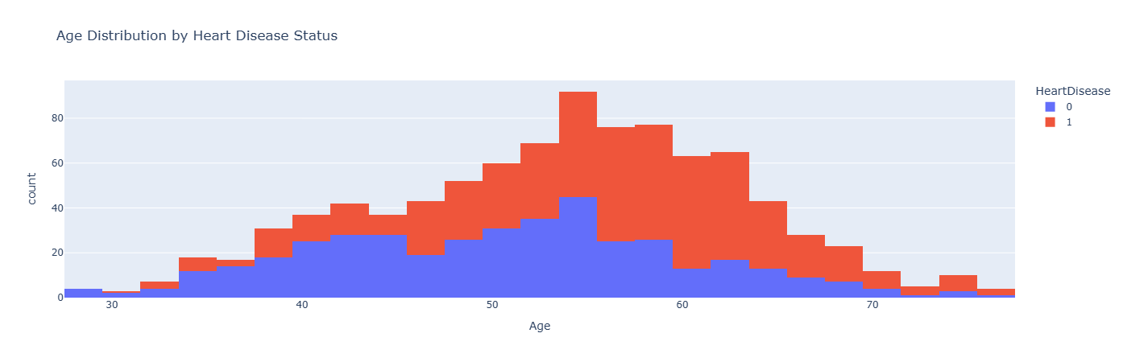

Slide 8
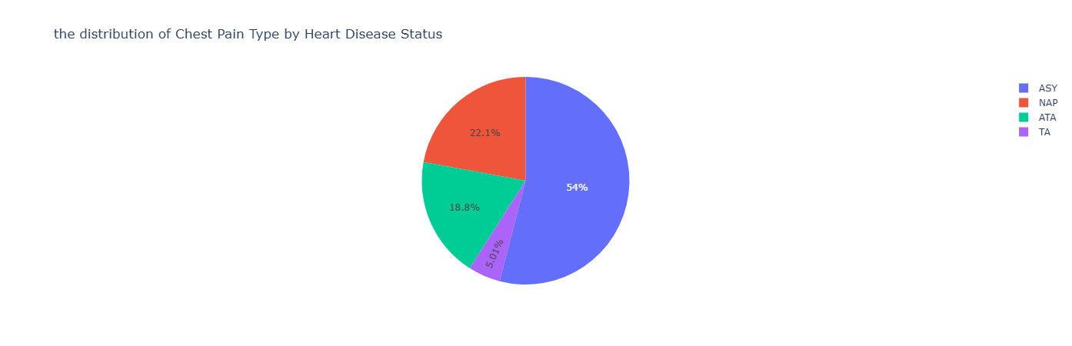
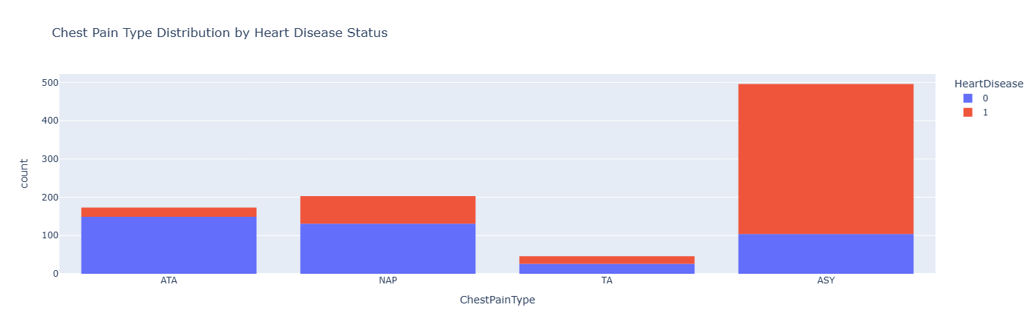

Slide 10
Sex (M, F)ChestPainType (ASY, NAP, ATA, TA)RestingECG (Normal, LVH, ST)ExerciseAngina (N, Y)ST_Slope (Flat, Up, Down)
Feature selection
Sex (M, F)
ChestPainType (ASY, NAP, ATA, TA)
RestingECG (Normal, LVH, ST)
ExerciseAngina (N, Y)
ST Slope (Flat, Up, Down)

Slide 11
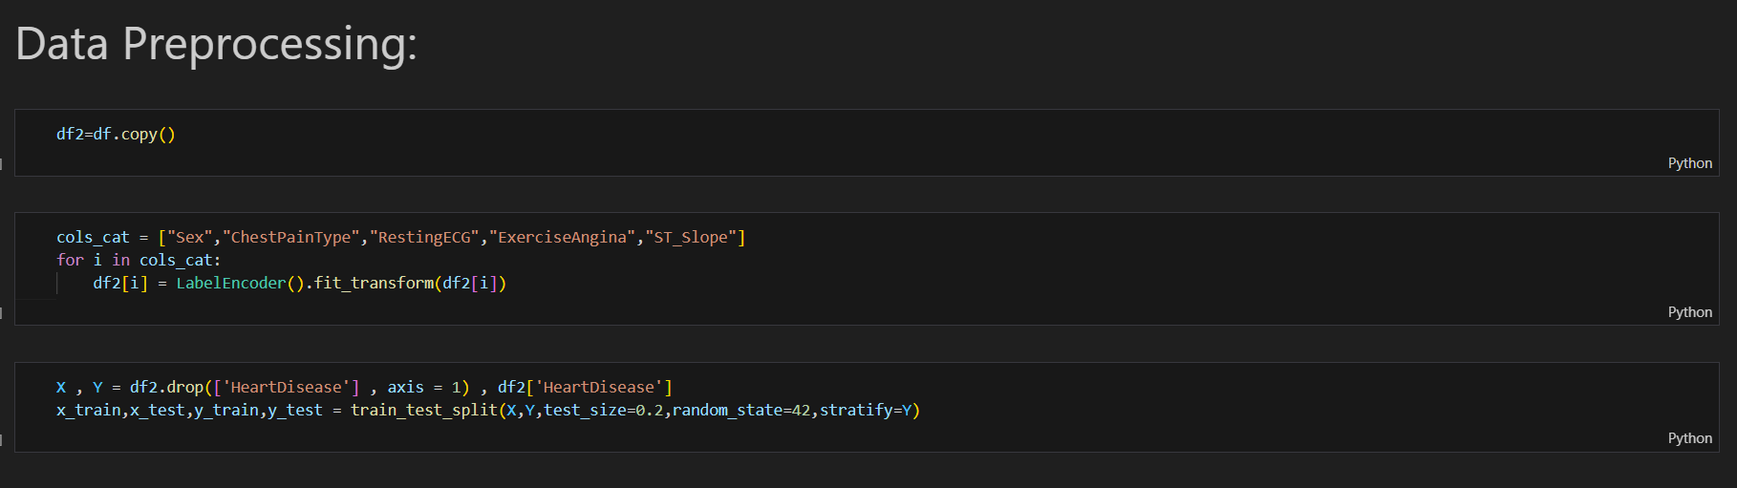
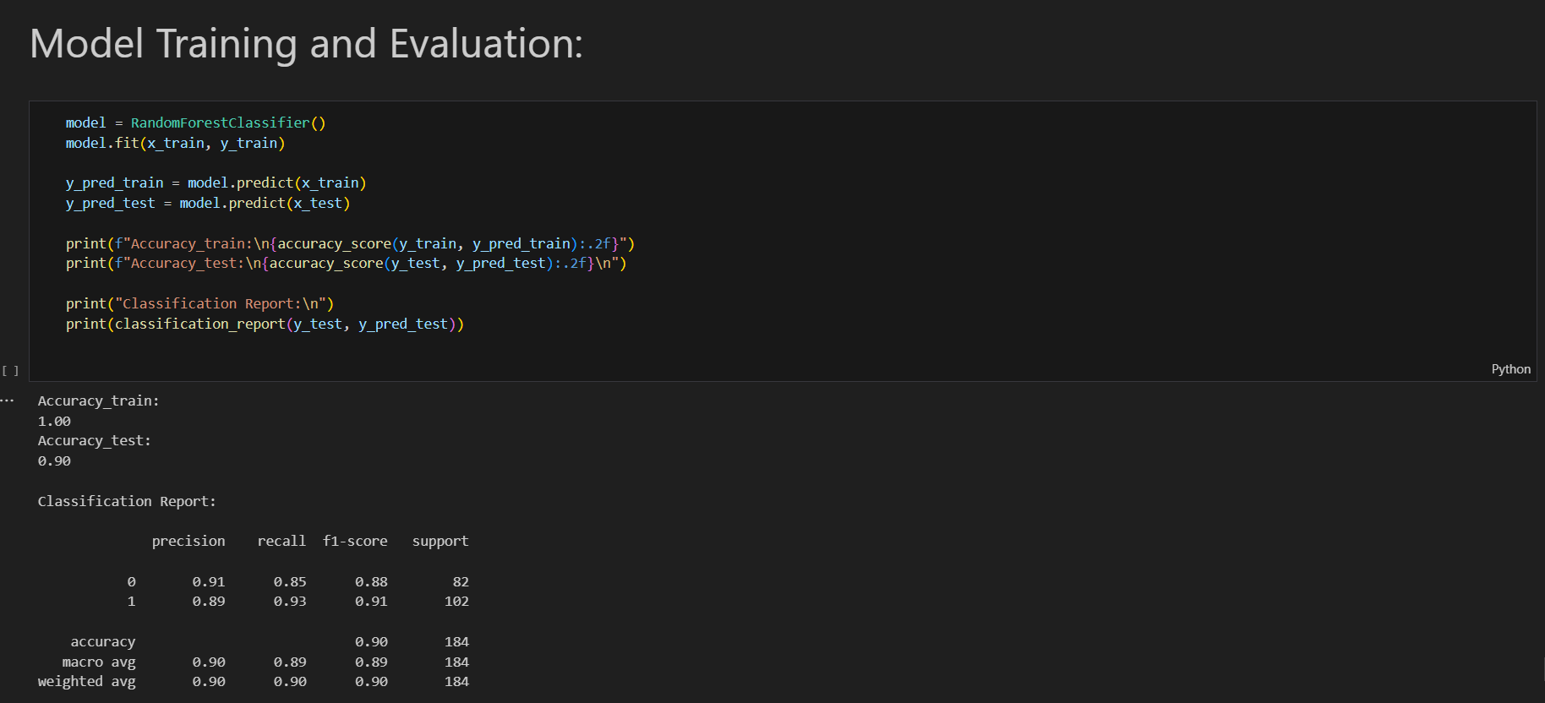

Slide 12

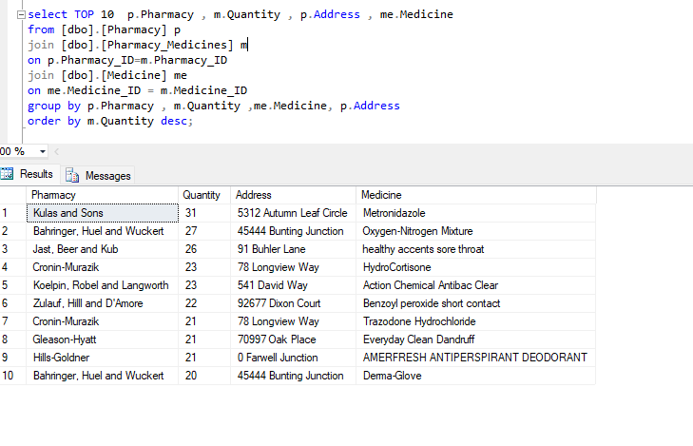

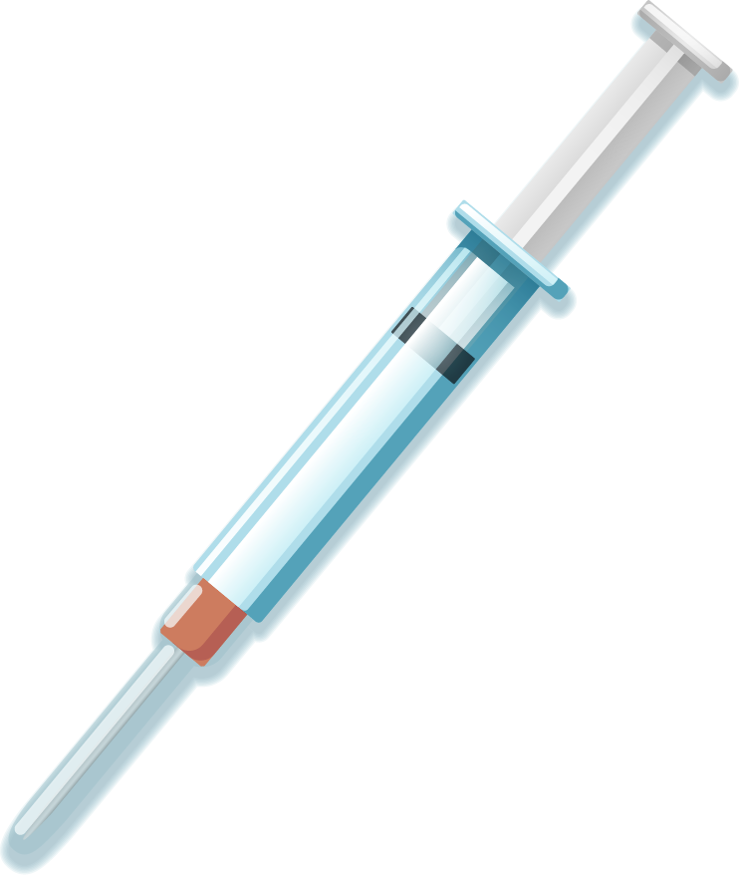
Top 10 Medicines found in Pharmacies

Slide 13
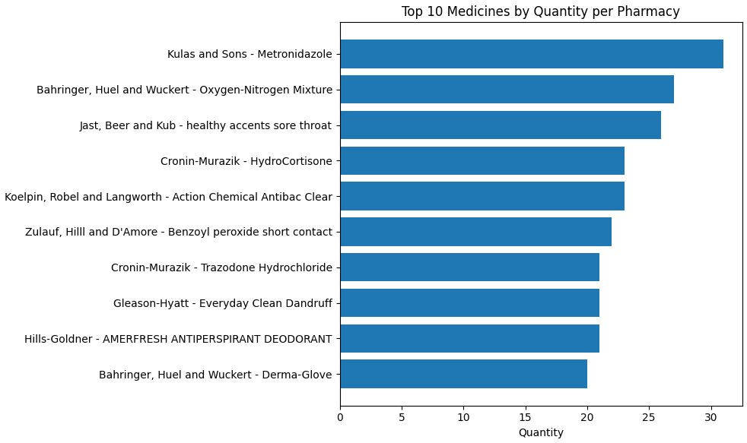
Top 10 Medicines found in Pharmacies

Slide 14


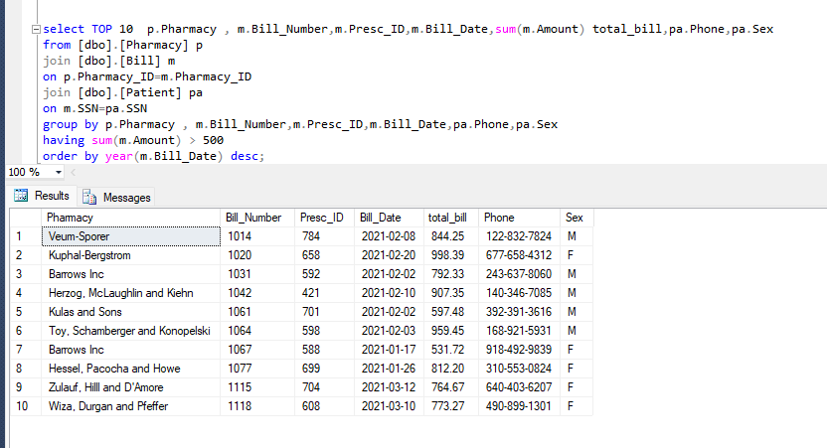
Total bills paid in pharmacy classified on patient sex

Slide 15
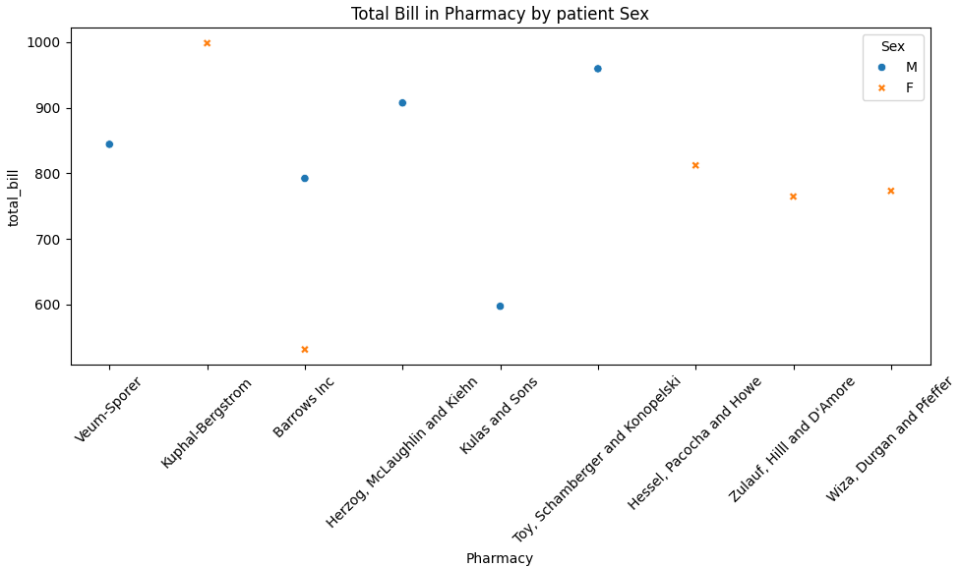
Total bills paid in pharmacy classified on patient sex

Slide 16
Total employees in pharmacy classified by sex

Slide 17
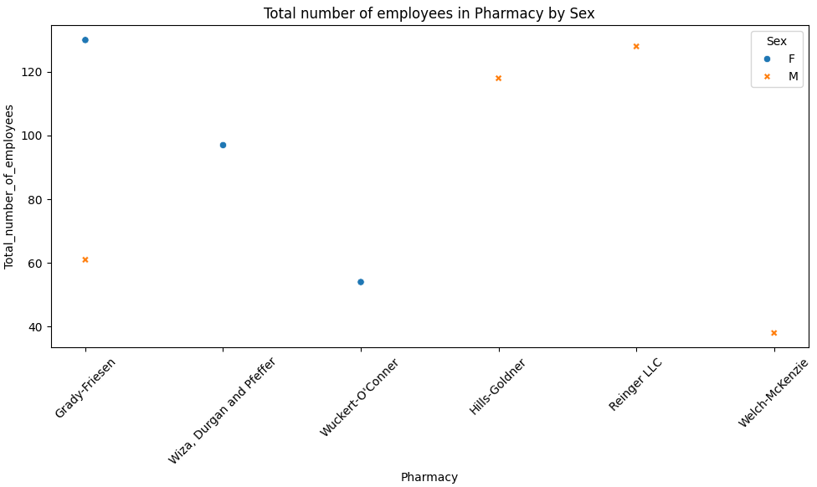
Total employees in pharmacy classified by sex

Slide 18
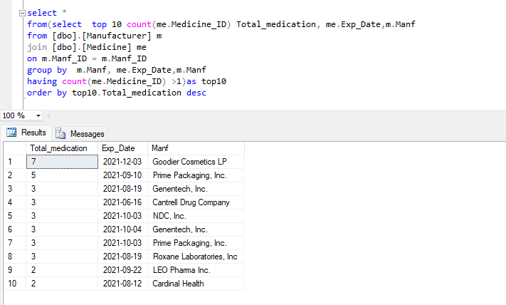

Medication expiry data for each manufacturer

Slide 19
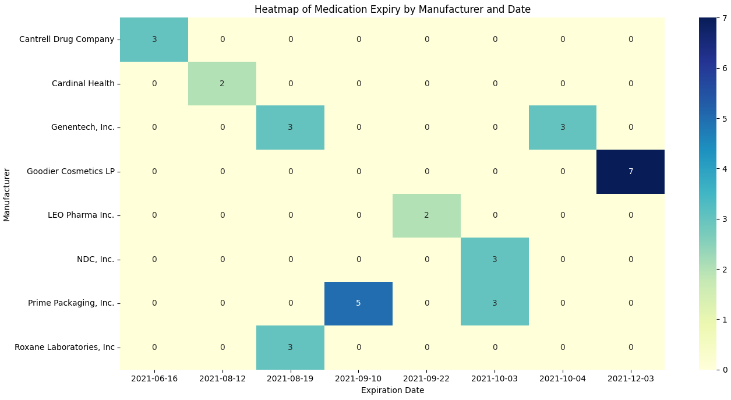
Medication expiry data for each manufacturer

Slide 20
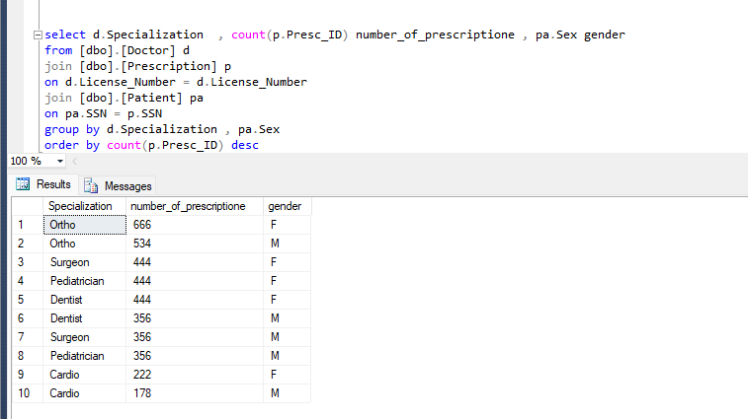
Prescriptions classified by specialization and gender

Slide 21
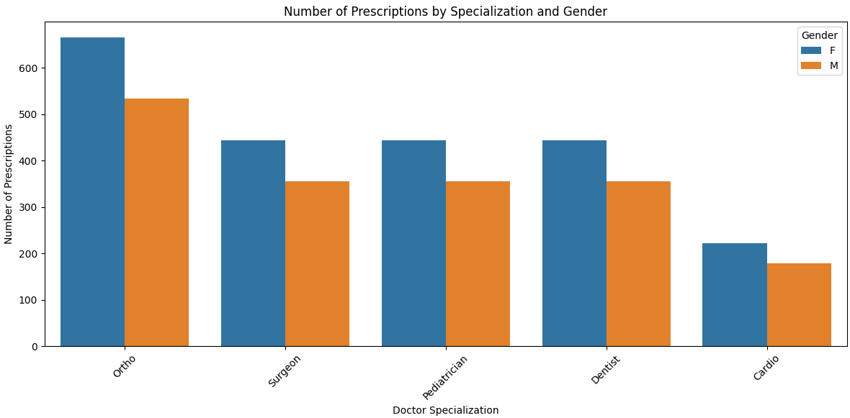
Prescriptions classified by specialization and gender

Slide 22
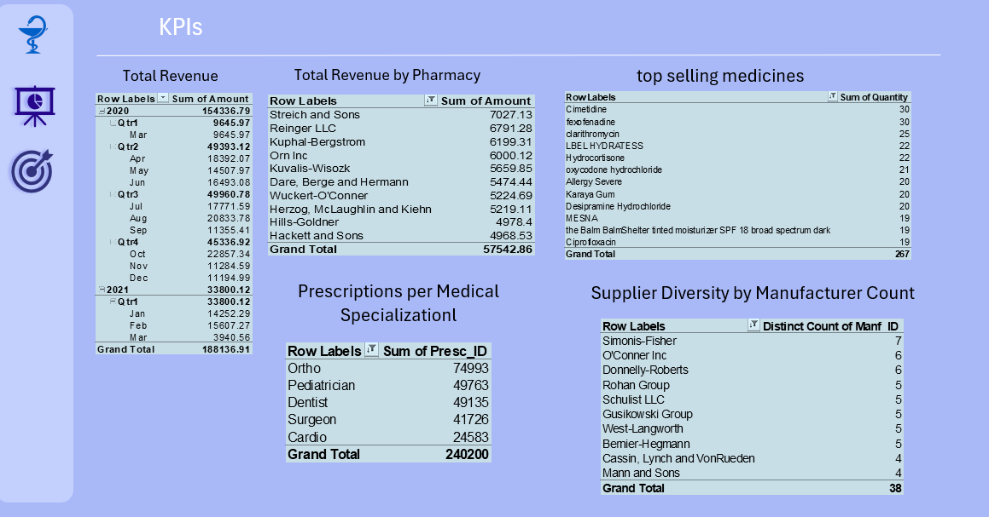

Slide 23
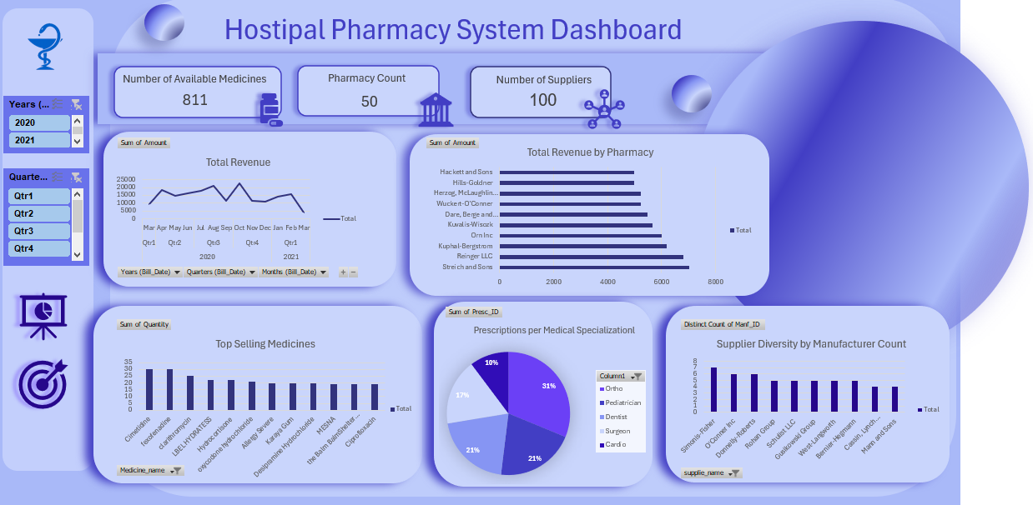

Slide 24

Insights
1-Number of Available Medicines (811):
The system offers a wide variety of medicines, indicating a well-stocked and diverse inventory.
2-Pharmacy Count (55):
A moderate number of pharmacies are integrated into the system, suggesting a focused or regional distribution network.
3-Number of Suppliers (100):
High supplier participation supports strong supply chain reliability and product variety.

Slide 25
Insights
Total Revenue (Line Chart)
Total Revenue Over Time:
Revenue trends fluctuate throughout the year, with noticeable peaks that may align with seasonal demand or promotional periods.
Total Revenue by Pharmacy (Bar Chart)
Top Revenue-Generating Pharmacies:
"Hackett and Sons" leads in revenue generation, potentially indicating higher traffic, better location, or stronger customer base.
Top Selling Medicines (Bar Chart)
Top Selling Medicines:
Medicines like Cimetidine, Fexofenadine, and Clarithromycin are the most in-demand, reflecting high needs for gastrointestinal, allergy, and antibiotic treatments.

Slide 26
Insights
Prescriptions per Medical Specialization (Pie Chart)
Medical Specialization Distribution:
Orthopedic and pediatric specialists account for over half of prescriptions, revealing a significant focus on musculoskeletal and child health.
Supplier Diversity by Manufacturer Count (Bar Chart)
Supplier Manufacturer Diversity:
Suppliers like Simons Petit and Cosmetics Inc. lead in manufacturer diversity, contributing to a resilient and varied pharmaceutical supply chain.
.

Slide 27
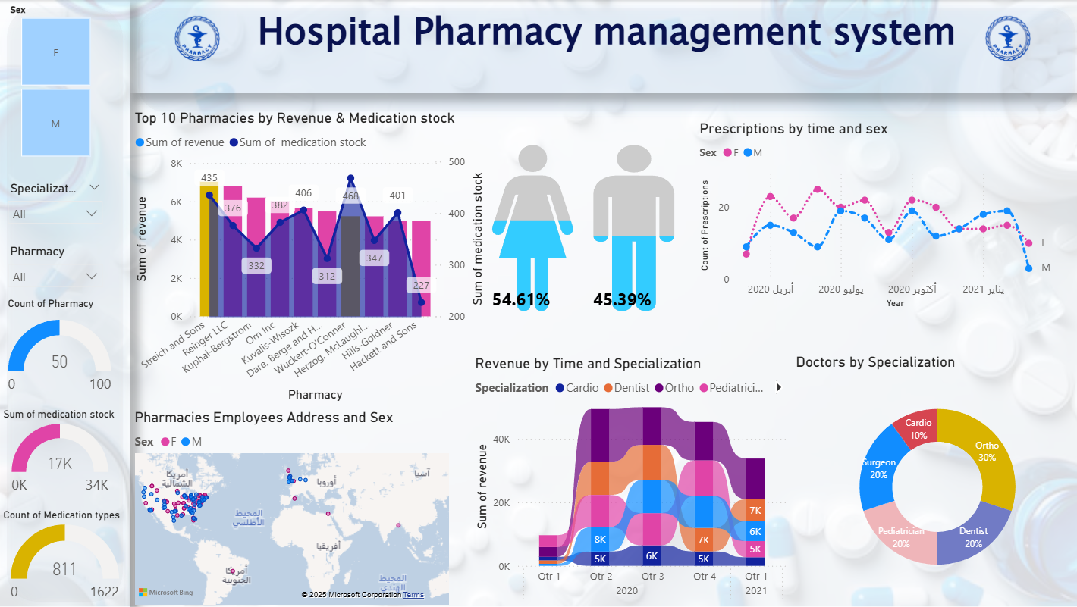

Slide 28
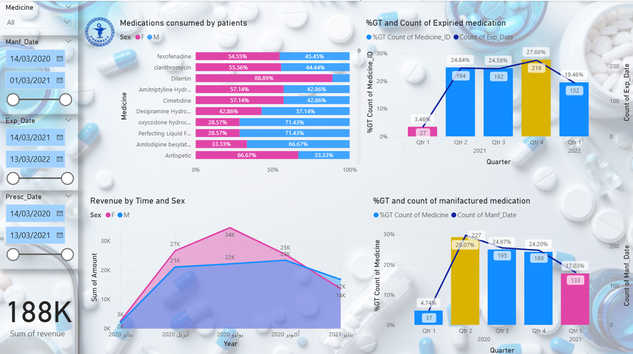

Slide 29
Insights
Wuckert-O'Conner Pharmacy holds the highest medication stock: 465 units with a total revenue of 5,224.69.
Streich and Sons Pharmacy achieved the highest revenue: 7,027.13 with 432 units in stock.
North America is the top region contributing the majority of pharmacy employees.
Female patients make up 54.61% of the total and had the most prescriptions in June 2020.

Slide 30
Insights
Orthopedic specialization generated the highest pharmacy revenue, representing 30% of all prescriptions, peaking in Q2 2020 with 16,620.
Dexamethasone and Dilantin are exclusively consumed by female patients.
Fexofenadine and Diethylpropion are consumed equally (50%) by both genders.
Kinray Vitamin AD and Fair and Square are more consumed by males, while most medications are female-dominated in consumption.

Slide 31
Insights
The highest revenue (34K) from pharmacies came from female patients in June 2020.
27.66% of medications will expire in Q4 2021 — the highest among all quarters.
Only 3.46% of medications expire in Q1 2021 — the lowest.
29.07% of medications were manufactured in Q2 2020, the highest manufacturing rate.
The lowest manufacturing rate was in Q1 2020 at 4.74%.

Slide 32

THANK
YOU

